Slide 1



DEPARTMENT OF ELECTRICAL AND ELECTRONICS ENGINEERING
EEB1204 - ELECTRON DEVICES AND CIRCUITS
FINAL REVIEW
PLANT MOISTURE MONITORING SYSTEM
YEAR/ SEMESTER – II/III
BATCH NUMBER : 1
DATE :21-11-2024
PRESENTED BY:
ABARNA S (927622BEE001)
GUIDED BY:
Dr.S.Banumathi, M.E., Ph.D,
Professor /EEE

Slide 2
ABSTRACT
A Plant Moisture Monitoring System is a simple yet effective solution for maintaining the health of plants by continuously monitoring soil moisture levels. This system uses an Arduino Uno, a soil moisture sensor, and an optional LCD display to determine whether the soil is wet or dry.
The primary goal of this project is to assist users in ensuring optimal water levels for their plants, which is critical for healthy growth. The system operates by reading data from a soil moisture sensor, processing it using the Arduino, and displaying the status on an LCD screen. This makes it an ideal tool for gardening enthusiasts, farmers, and automated irrigation systems.

Slide 3
IDENTIFICATION & DEFINITION OF PROBLEM
Accuracy of Soil Moisture Readings: Soil moisture sensors may provide inconsistent or inaccurate readings due to varying soil types, salinity, or sensor degradation over.
Power Consumption: Continuous operation of the LCD and the Arduino board can lead to higher power consumption, especially in battery-powered systems.
Threshold Sensitivity: Predefined moisture thresholds may not suit all plants or environmental conditions, leading to false alerts or improper watering schedules.
Maintenance and DurabilityProblem: Soil moisture sensors and LCD modules may require regular maintenance or replacements due to wear and tear or environmental exposure.

Slide 4
LITERATURE REVIEW
Megh Sahasrabudhe
K. J. Somaiya College of Engineering(18 Jul 2023)
Monitoring the soil moisture of plants is crucial for their proper growth and health. However, it can be a tedious and time-consuming task to check these values manually. In this paper, we propose an Arduino Uno-based system that uses soil moisture and pH sensors to continuously monitor and helps to maintain optimal soil conditions for plants. The microcontroller of the system constantly checks the values and displays them on an LCD screen as well as the Serial Monitor for easy monitoring by the user.
The system offers an effective and efficient solution for maintaining healthy plants, making it suitable for use in home gardens, indoor plant setups, or even in commercial greenhouses. The paper describes the system’s design, implementation, and testing, along with its advantages and limitations. The proposed system provides an automated solution for insuring optimal soil moisture for plants, eliminating the need for manual monitoring and reducing the risk of plant decay or death due to neglect.

Slide 5
IDENTIFICATION OF ALTERNATE SOLUTIONS
IoT-Based Sensors: Deploy sensors to monitor soil moisture, temperature, humidity, and light levels. Data from these sensors can be sent to a central system for real-time monitoring and alerts.
Machine Learning: Implement machine learning algorithms to analyze data collected from sensors. This can help in predicting plant health issues and optimizing growth conditions based on historical data.
Automated Irrigation Systems: Combine sensor data with automated irrigation systems to ensure plants receive the right amount of water. This can reduce water waste and improve plant health.
Remote Sensing Technologies: Employ remote sensing technologies like satellite imagery to monitor large-scale agricultural areas, providing data on crop health, soil conditions, and more.

Slide 6
PROJECT OBJECTIVES
Real-Time Monitoring: To continuously measure soil moisture levels and display the status on an LCD screen.
Portable Design: To create a system powered by a battery with a voltage regulator for stable operation, making it portable and efficient.
User-Friendly Interface: To provide a simple, easy-to-read moisture status (e.g., "Dry," "Moist," or "Wet") on an LCD screen.
Cost-Effective Solution: To design an affordable tool for farmers, gardeners, or hobbyists to monitor soil conditions without complex setups.
Improved Plant Care Awareness: To help users make informed decisions about watering their plants based on real-time soil conditions.

Slide 7
PROJECT OBJECTIVES
Energy Efficiency: To design a system that consumes minimal power, ensuring prolonged operation on battery power.
Data Accuracy: To ensure precise and reliable measurement of soil moisture for better decision-making.
Customizable Thresholds: To enable users to set custom soil moisture thresholds based on specific plant requirements.
Low-Cost Implementation: To develop an affordable system suitable for small-scale and individual use.

Slide 8
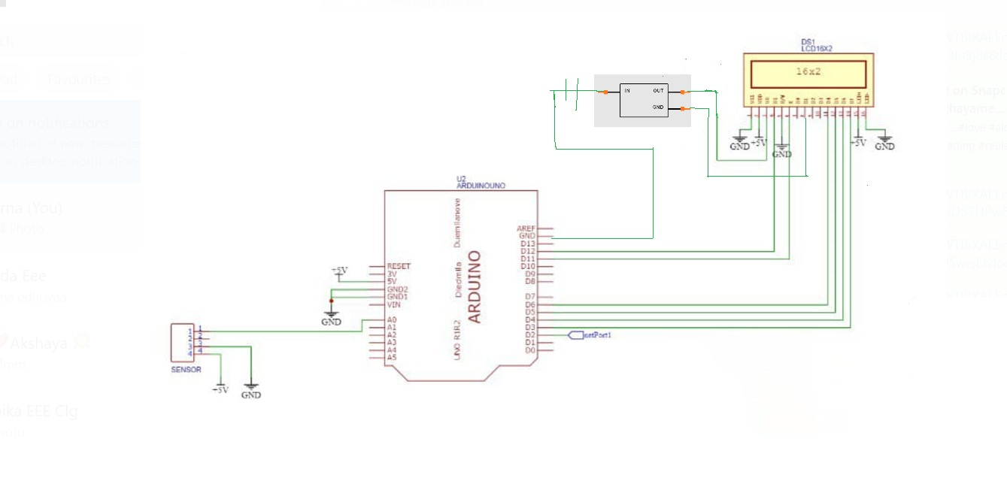
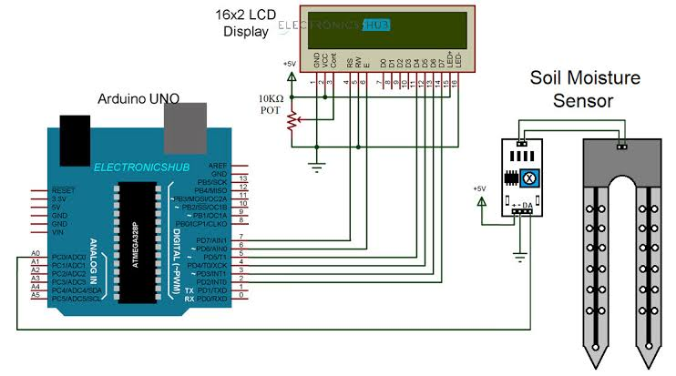
CIRCUIT DIAGRAM

Slide 9
COMPONENTS USED
Arduino Board
Soil Moisture Sensor
LCD Display
Power Supply
Voltage Regulator

Slide 10
COMPONENTS DESCRIPTION
Arduino UNO:
A microcontroller board that processes input from sensors and controls output devices. It is programmed via a USB connection to a computer.
Voltage Regulator(L7805CV):
The L7805CV is a popular fixed-output linear voltage regulator designed to provide a steady 5V DC output from a higher input voltage. It is part of the 7805 series, commonly used in electronic circuits requiring stable and regulated 5V power.

Slide 11
COMPONENTS DESCRIPTION
Soil Moisture Sensor:
A sensor that measures the moisture level in the soil. It typically has two probes that detect the soil’s wetness and send this information to the Arduino.
LCD Display:
A typical LCD (Liquid Crystal Display) module, such as the commonly used 16x2 LCD, consists of several key components that work together to display characters or graphics.

Slide 12
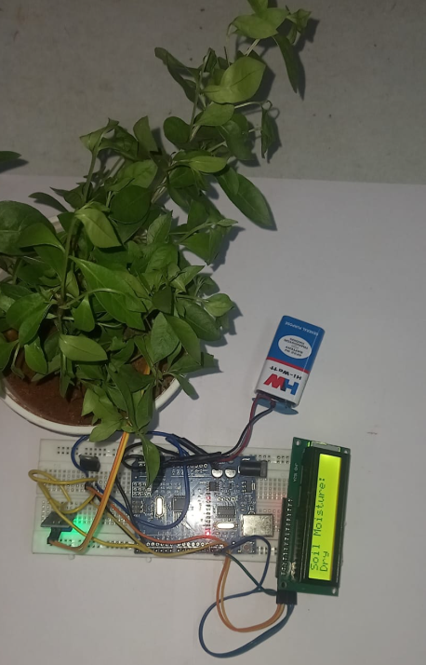
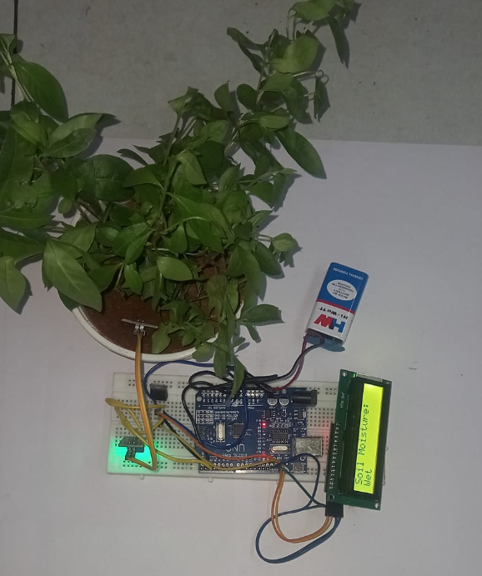
HARDWARE PHOTO

Slide 13
WORKING
1.Soil Moisture Sensor Functionality:
The soil moisture sensor has two metal probes that are inserted into the soil.When the soil is wet, it conducts electricity better, resulting in lower resistance and a higher analog output voltage.When the soil is dry, the resistance increases, and the analog output voltage decreases.
2. Arduino’s Role:
The Arduino Uno reads the analog voltage from the soil moisture sensor using one of its analog input pins (e.g., A0).It converts this voltage into a moisture percentage or value, which represents how wet or dry the soil is.
3. Display Module:
The measured moisture value is displayed on an LCD or OLED display for easy monitoring.The display might show a (“Soil is Wet”) or (“Soil is Dry”)

Slide 14
WORKING
4. Power Supply:
The battery serves as the power source for the system. The L7805CV voltage regulator ensures a stable 5V supply to the Arduino, sensor, and LCD display. The regulator takes input from the battery (typically 7-12V) and outputs a regulated 5V DC.
5. Display Module:
The measured moisture value is displayed on an LCD or OLED display for easy monitoring. The display might show a (“Soil is Wet”) or (“Soil is Dry”)

Slide 15
CODING
#include <LiquidCrystal.h>
sensorconst int sensorPin = 2;
void setup() {
lcd.print("Soil Monitor");
delay(2000);
lcd.clear();
pinMode(sensorPin, INPUT);
}
void loop() {
int sensor State = digital Read(sensorPin);
digital Read(0, 0);
lcd.print("Soil Status:");
digital Read(0, 1);
if (sensor State == LOW) {
lcd.print("The soil is wet");
} else {
lcd.print("The soil is dry"); }
delay(2000);
lcd.clear();
}

Slide 16
OUTPUT
Expected Output on LCD
Case 1: When the Soil is Wet
Soil Status:
The soil is wet
Case 2: When the Soil is Dry
Soil Status:
The soil is dry

Slide 17
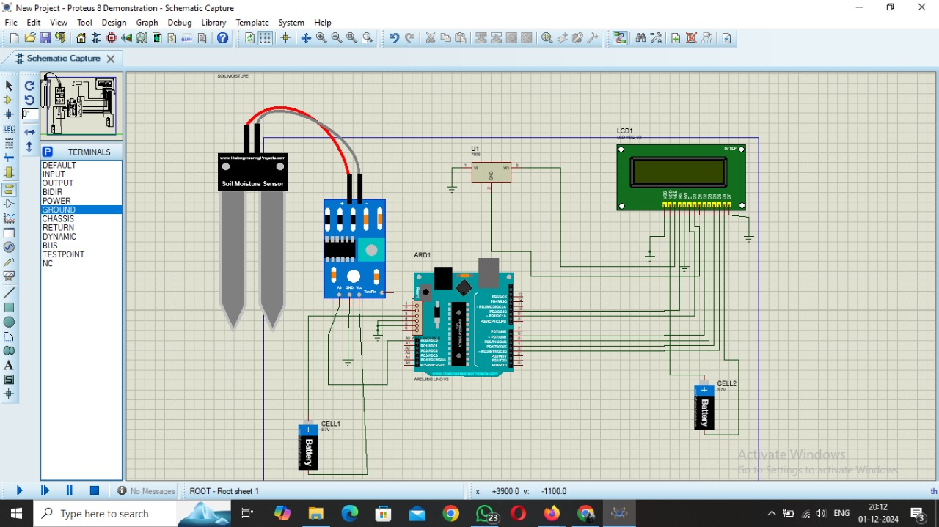
SIMULATION

Slide 18
CONCLUSION
The Arduino-based plant moisture monitoring system is an efficient, cost-effective, and user-friendly solution for maintaining optimal soil moisture levels for plants. By integrating a soil moisture sensor, display, and optional alert mechanisms, it provides real-time data about soil conditions.
This system ensures better plant health by alerting users to water the plants when necessary or automating irrigation processes. Its simplicity and scalability make it suitable for home gardens, greenhouses, and agricultural applications.
Moreover, it encourages resource-efficient practices, reducing water wastage and promoting sustainable gardening.

Slide 19
FUTURE ENHANCEMENT
Automated Irrigation: Integrate a water pump controlled by a relay to automate the watering process when moisture levels drop below a set threshold.
IoT Integration: Connect the system to the Internet using modules like ESP8266 or ESP32 for remote monitoring and control via a smartphone app or web interface.
Multi-Sensor Network: Deploy multiple sensors to monitor moisture levels in different areas of a garden or farm and optimize irrigation per zone.
Weather Monitoring: Include additional sensors (e.g., temperature, humidity, and rain sensors) to create a comprehensive weather station for smarter irrigation decisions.
Mobile Notifications: Set up alerts via SMS, email, or mobile apps to notify users when soil moisture drops to critical levels.

Slide 20
REFERENCE
IEEE: Automatic plant monitoring system on 2017 International Conference on Trends in Electronics and Informatics (ICEI)
Nermin Duzic(International BURCH University) June 2017 Collegium Antropologicum 41(2):169-172 “Automatic Plant Watering System via Soil Moisture Sensing”
International Journal of Engineering Research & Technology (IJERT) http://www.ijert.org ISSN: 2278-0181 IJERTV10IS090003 (This work is licensed under a Creative Commons Attribution 4.0 International License.) Published by: www.ijert.org Vol. 10 Issue 09, September-2021.
Smart Agricultural Technology Volume 2, December 2022, 100032 Automation of soil moisture sensor.

